Slide 1
HOME AUTOMATION
A Real Project which can be readily installed in Home!
APPAJI CHINTIMI
1901CS17

Slide 2
Short and Sweet Disclaimer
I prepared this PPT by keeping reader in mind. So, I made this in such a way that, Reader doesn’t get bored by some routine content. There is no slide in this PPT which contains just some Random Info from Internet. Every line and element is well thought and put here in the slides. Please give it a read.
And, I made this PPT as conversation. So, This contains some conversational humour at some slides, a movie scene in another. Again, Every element is put here just to better engage with the Reader.
Appaji Chintimi

Slide 3
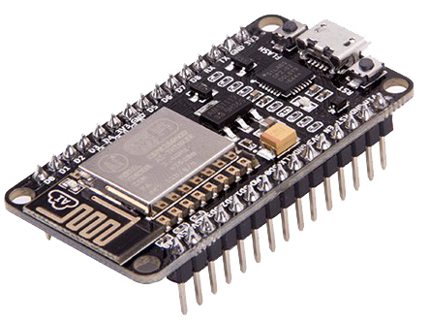
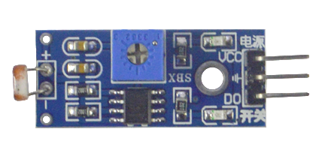
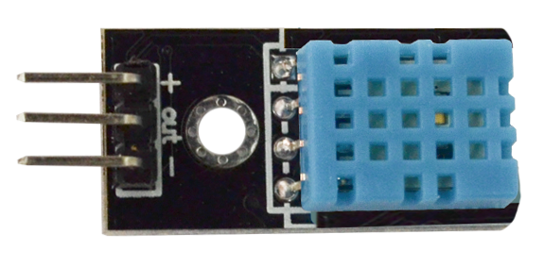
MATERIALS USED
LDR Sensor Module
Light Dependent Resistor Module. Value of Resistance changes based on intensity of Light falling on it. So, Technically, We can get a measure of Light Intensity with this.
NodeMCU Wi-Fi Development Board
Heart of this Project. Adds Wi-Fi functionality to Arduino Boards, by having ESP8266 Module in-built.
DHT11 Sensor
Measures Temperature and Relative Humidity between it’s electrodes.

Slide 4
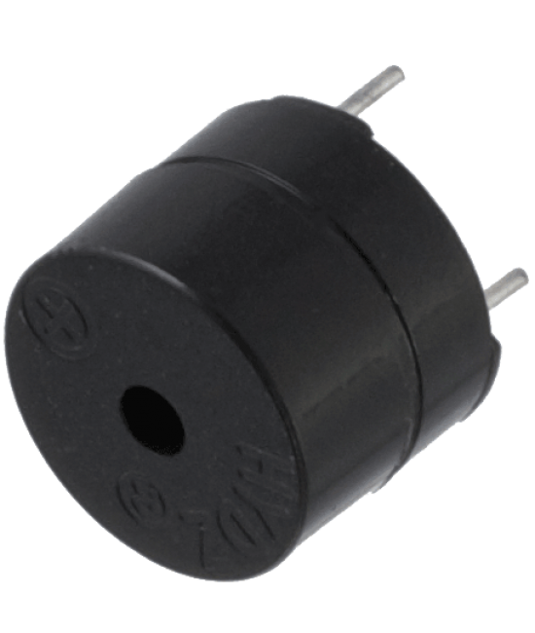
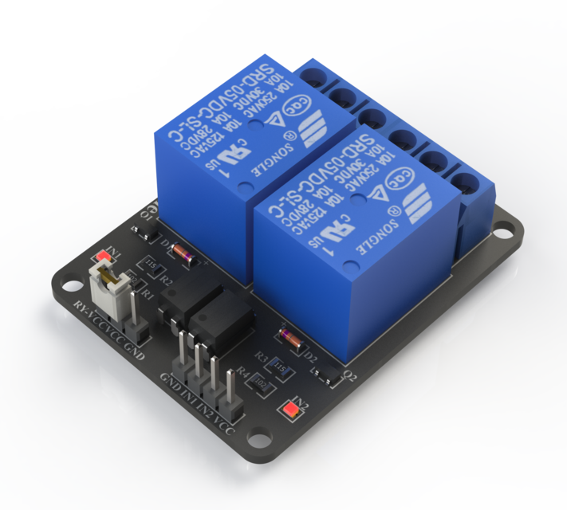
MATERIALS USED
And Few Obvious things like Bread-board and Jumper wires, LEDs.
Electromagnetic Buzzer
Pretty Simple Element, which produces sound when connected to more than 3V
2-Channel Relay Module
This allows to control 240V appliances with low Voltage by acting as a switch. More on this in next slides.

Slide 5
Introduction
This project contains 2 Independent parts which somehow fall into Automation Category.
Controlling Real Home Appliance from literally anywhere [with Internet]
Home Security System [Inspired from a Movie]

Slide 6
01
Controlling Real Home Appliance {from literally anywhere}

Slide 7
Concepts Involved
MQTT Protocol
Relay Module
MQTT Protocol
Before diving into what is MQTT, We’ll discuss about traditional Client-Server Model. In Client-Server Model, Client is the one who sends messages and Server receives it. Server cannot send messages to client back. [Why?] Server is assumed to be always listening for Clients. Clients are not like that. They don’t listen for Server’s response, because Server doesn’t send any.

Slide 8
MQTT Protocol
Did you see the drawback? The communication is one-way. But our use case is different. A typical user expects in this way. They should be able to control appliances over the Internet. They should be able to view the status of the appliance [ON/OFF etc.…]
Here, We require two-way communication. With few modifications that can be implemented similar to Client Server Model. But both have to be listening for other’s messages. That’s where MQTT had born…

Slide 9
MQTT vs HTTP (Points Ranked from Top)
MQTT | HTTP
In 3G network, I am 93 times faster than HTTP. 😎 | We’ll ignore in 3G mode. I am much faster in 4G and 5G networks though. 😕
I guarantee data delivery and various features in sending data. 🚚 | I’m gonna pretend like, I never heard of this. 😑
Optimized data packets | More detailed and large set of specifications in data packets.
SSL/TLS is built-in. 🛅 | HTTPS🔐 is built for a reason. 🙄
Designed specifically for IoT | I am designed for variety of use cases. I win here😈

Slide 10
Relay Module
As discussed earlier, Relay Module allows us to control High Voltage appliances with low Voltage currents.
How this is being done?
It contains a mechanical switch and Inductor. Inductor can detect the currents passing through it. And when passed current (low Voltage, 10mA approx.) It opens/closes the Switch. [Illustration in next slide]
PS: We can hear the switch toggling inside the Relay. Watch Demo for example.

Slide 11
Relay Module (continued…)
Relay Module has 3 Output pins and 3 (4 also possible) Input pins. Input pins are pretty simple. V_{CC} and G.
Output Pins :-
CO – Common Output
NO – Normally Open
NC – Normally Closed
Refer right figure for context

Slide 12
Relay Module (continued…)
CO pin toggles between NO pin and NC pin. NC pin is closed by default. Similarly, NO is open by default. They toggle their states when current is passed through Inductor[Input Pin]
Here’s an Implementation detail
Users expect that, When this IoT module isn’t working properly to control their appliance, At least it should work with manual switch, Right?
If we use CO and NO pin for our product, It isn’t possible. Unless until Arduino decides the switch is closed, The Bulb remains off, No matter the power supply given to Bulb.

Slide 13
Relay Module (continued…)
Here’s the trickery. We’ll connect AC wires to CO and NC pins. So, If Arduino is not working / can’t connect to Internet, At least manual switches does the job, just as normal house hold appliance.
PS: This is better explained in Demo Video.
We’re using Ubidots for MQTT Service, And their official Library. We’ll discuss about this in next part again.

Slide 14
02
Home Security System [Inspired from Dhoom Movie]

Slide 15

Pardon if you see this is as unprofessional. My sole intention is to better engage with the reader.

Slide 16
What we did exactly?
There would be constant source of light falling over LDR Sensor. In case the Light ray is interrupted, Alarm would turn on. Also, NodeMCU sends an email to us. It also records current Room Temperature and Relative Humidity and adds it to Email content.
It’s not difficult to use IR emitter instead of Visible Light as portrayed in movie. But then, We require a special lens to be able to see those rays clearly.

Slide 17
Concepts Involved
Interacting with SMTP Server
DHT11 Sensor
SMTP Server
There are many libraries for NodeMCU, which greatly simplifies sending mail from any SMTP service. But, I found some drawbacks with them [specific to my use case]. So, I made one library from existing one.
Remember about Ubidots Library in previous slide? I customized that library such that, the same library is now able to send mails as simple as calling a function.

Slide 18
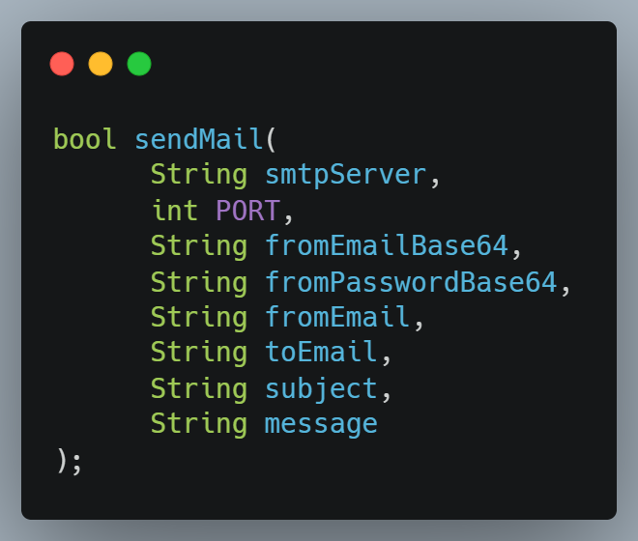
SMTP Server (continued…)
I published that library on GitHub here.
It exposes a function sendMail() with following parameters.
I guess those parameters are self-explanatory.

Slide 19
DHT11 Sensor
This sensor enables us to know Room Temperature and Relative Humidity. Well, not really room.
It measures Temperature based on Resistance change of it’s electrodes. And relative Humidity by measuring resistance between electrodes.
The readings of this sensor will be included in the mail body.

Slide 20
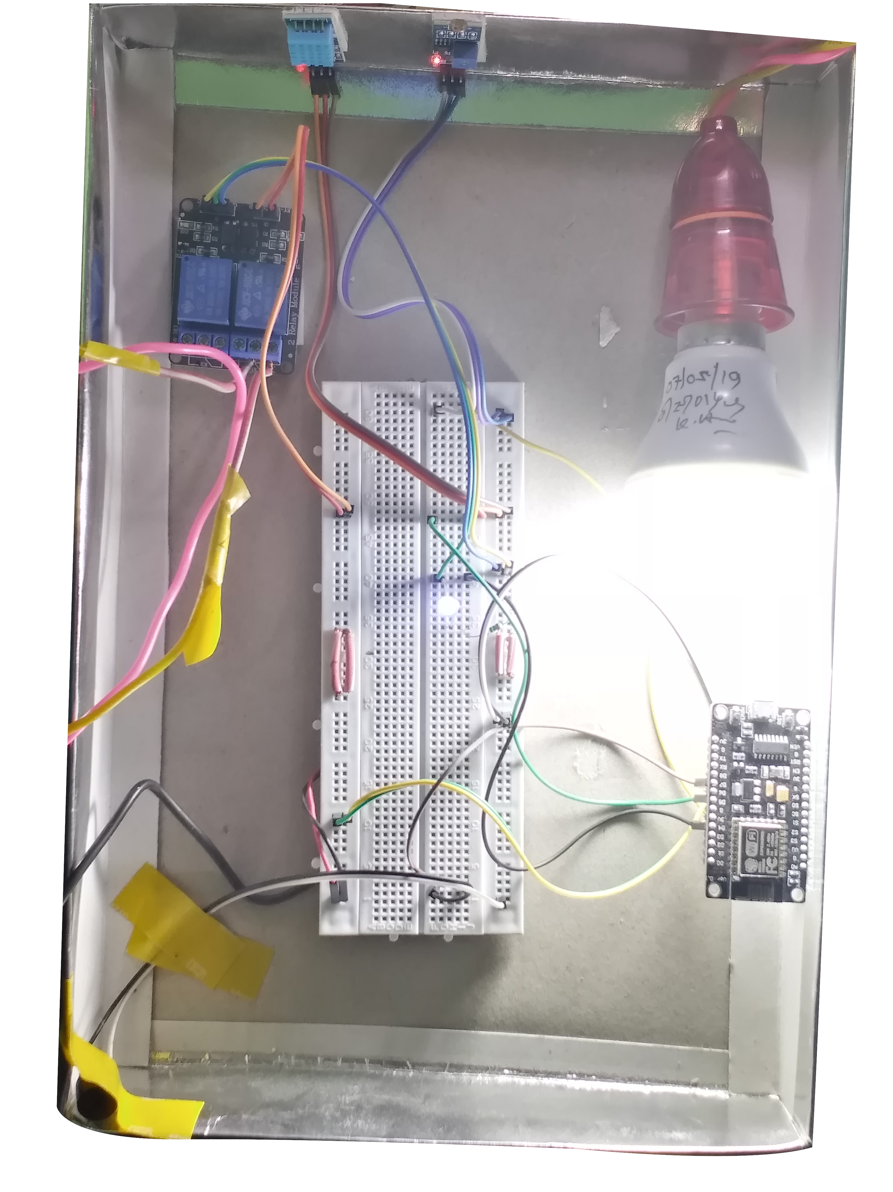
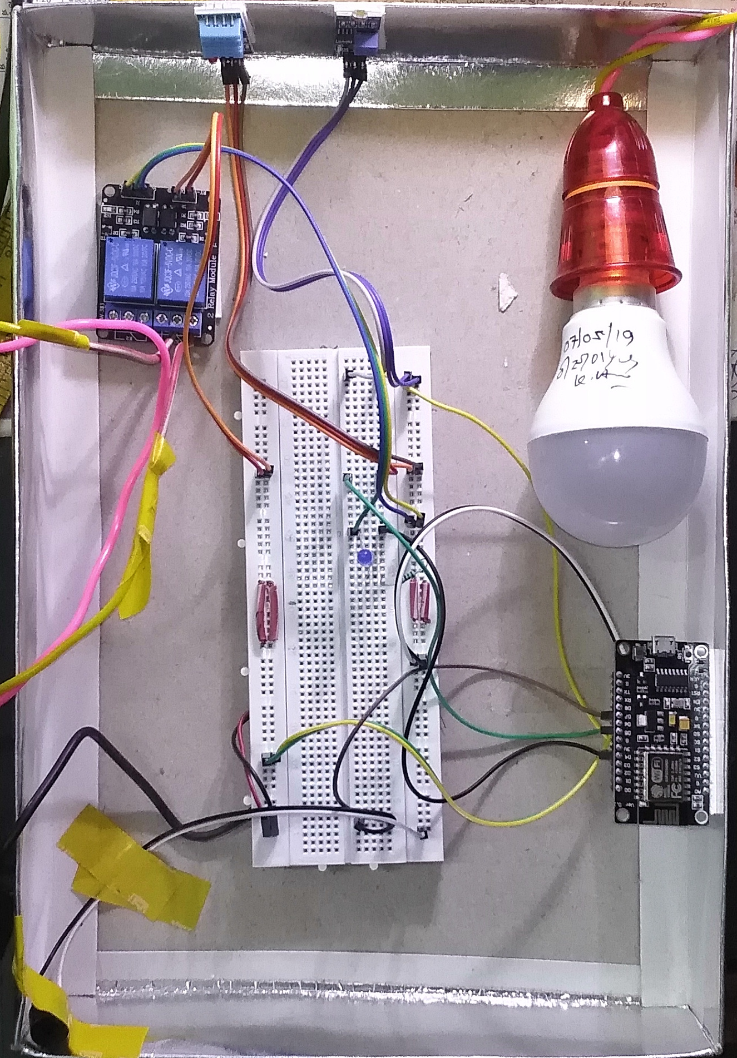
Circuitry

Slide 21
thanks
Appaji
1901CS17
Visit next slide for Credits & Contributions

Slide 22
Credits & Contributions
Code is entirely written by me, Although, I mention some references which helped me during the process.
Ubidots Official Documentation, DHT11 Official Documentation
The exact Ubidots Library didn’t work out well for this project. I faced trouble in sending E-mail, while using Ubidots Library.
So, With few changes, I published my own version of Ubidots Library which is able to send emails as simple as calling a function. (Yep, Just a function, That simple!!). You can view it here.

Slide 23
Credits & Contributions
Part–1 : Controlling Home Appliance
Circuitry – Appaji
Code – Appaji
Part–2 : Home Security System
Circuitry – Appaji
Code – Appaji
Custom Ubidots Library for Email - Appaji

